Slide 1



Slide 2

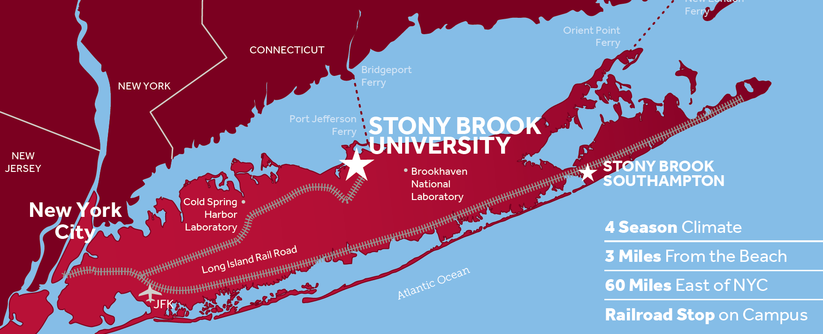
27,000
Total
Students
18,000
Undergrad Students
100+
Countries
4,000+
International Students
Notes:
SUNY – 64 campuses and 4 university centers
Founded in 1957
Size of Campus – almost 1,100 acres
Total Enrollment – around 27,000 with our undergrad, grad and doctorate students
Undergrad Enrollment – just about 18,000 undergrads
Total Faculty & Staff - ??
Location sets us apart from other SUNY
60 mi from NYC. 60 mi from Montauk, and only 5 mins from LI sound
North Shore of LI
Minutes from Port Jeff, Beach, Mall
Accessible for all: LIRR right on campus, about 90 min train ride from Penn. Parking lots for those that drive, and SCT busses and close to LI MacArthur airport
West Campus is everything you think of when you think of a college campus: many different classroom buildings, multiple libraries, SAC, SB Union, Arena, Football Stadium, indoor sports facility, rec center, 8 different living communities, art galleries, Staller Performing Arts Center, and so much more.
Other SBU Sites:
SB Hospital, HSC, Renaissance School of Medicine, School of Dental Medicine
Southampton Campus with the Marine Research Center
R&D Park off campus
Co-manage the Brookhaven National Laboratory

Slide 3
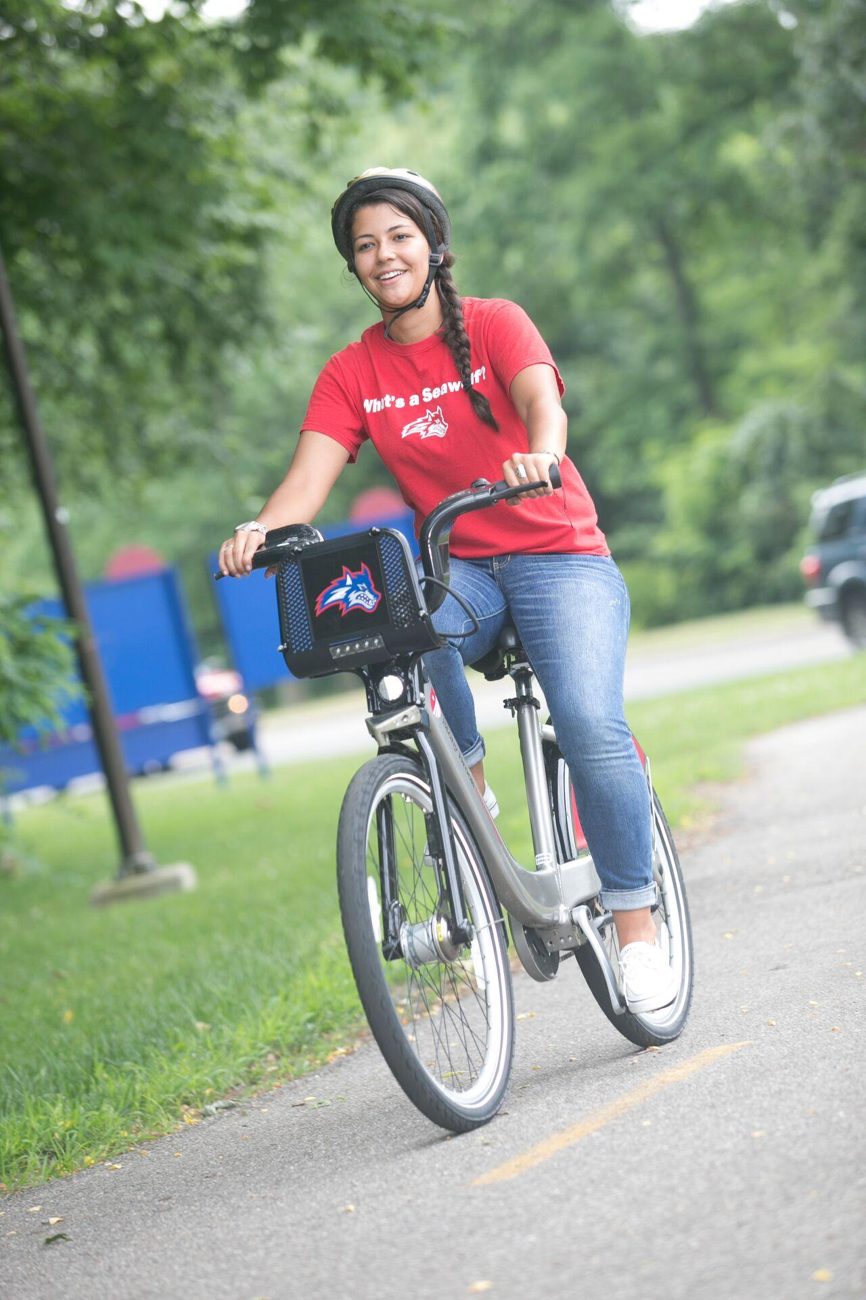
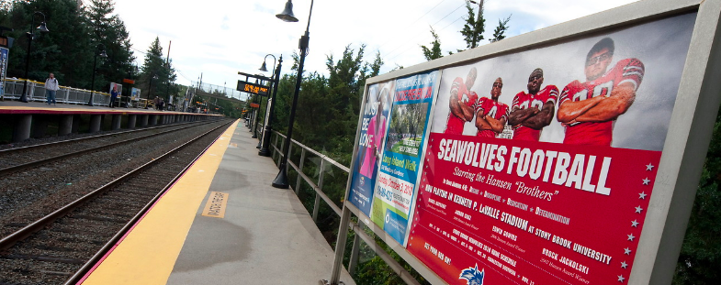
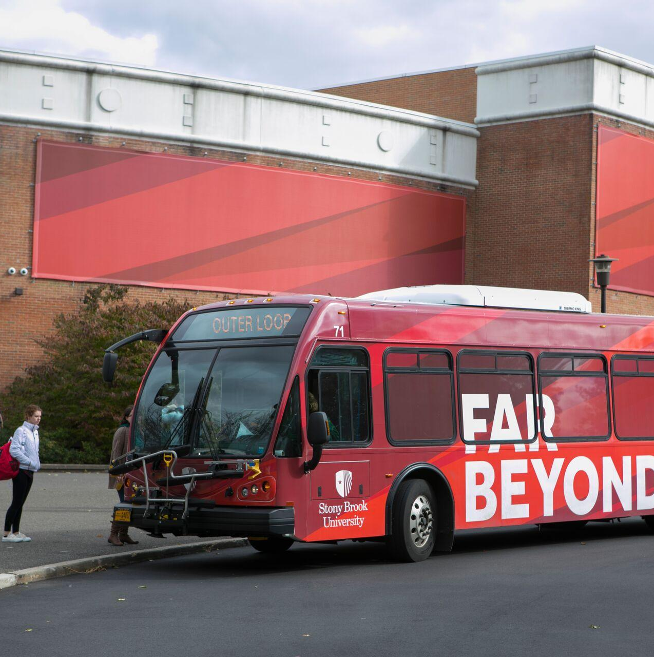
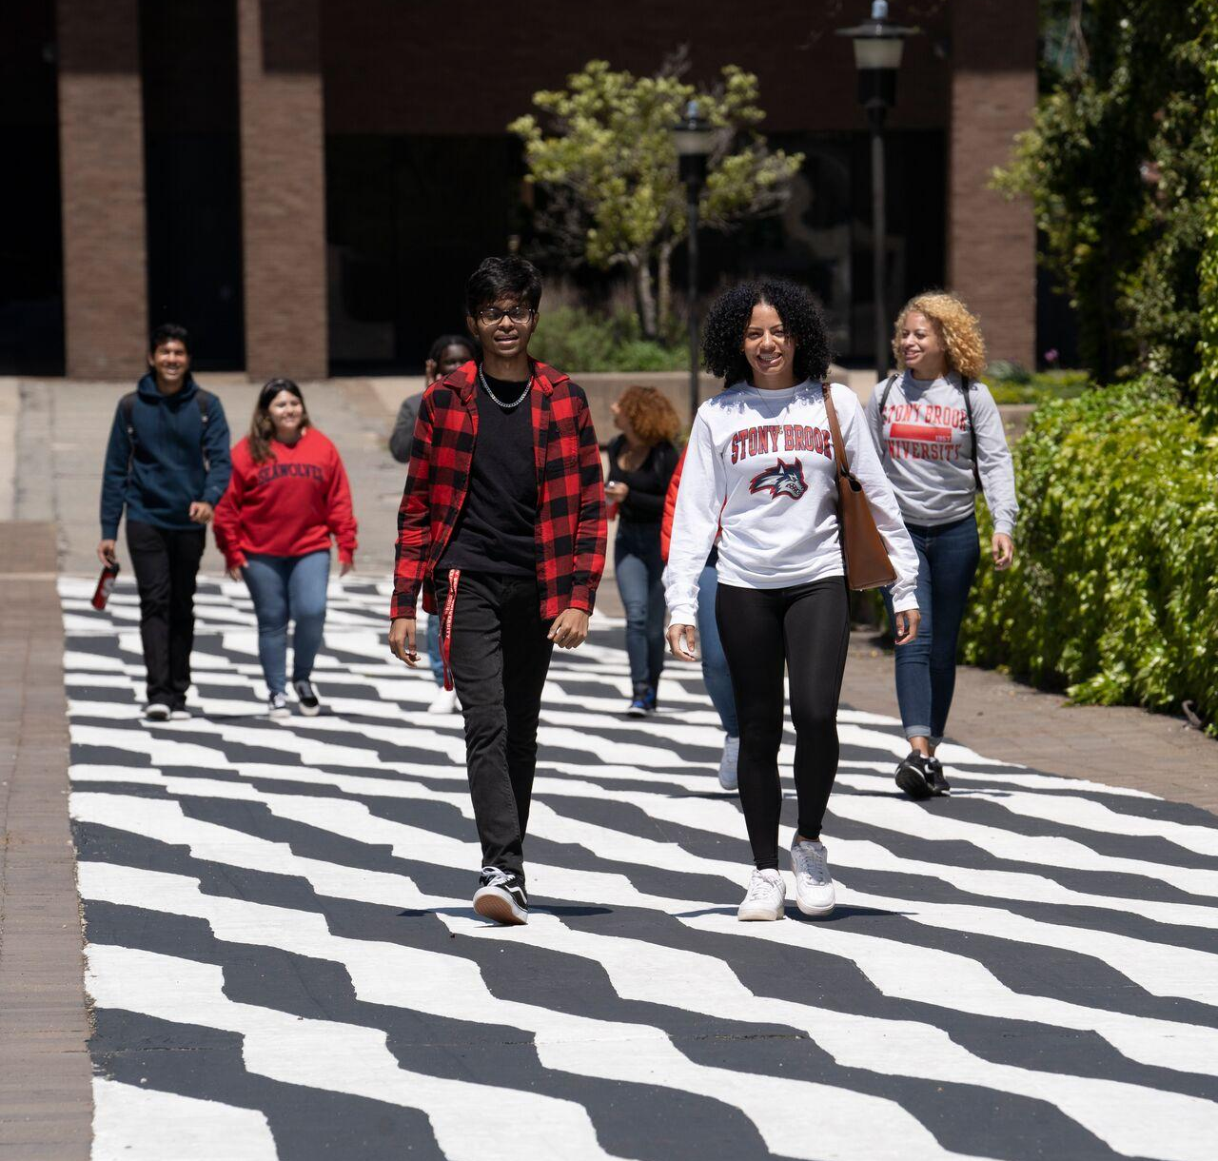
Getting Around Campus
Notes:
LIRR Station on north side of campus
SBU Buses – app with real times of multiple lines, continuously running throughout the day and some of them into the night
SBU Shuttles – typically nights and weekends, to local spots – Port Jeff, Movies, Mall, Target, Outlets, etc.
Suff
olk County buses – to get to wherever you need to go throughout Suffolk County, or transfer to the airport or other locations
Wolfie Bike Share – much like CitiBike or other bike rentals in major cities, except free for 1st hour for our students
Walkable and bike paths plus the Ashley Schiff preserve

Slide 4
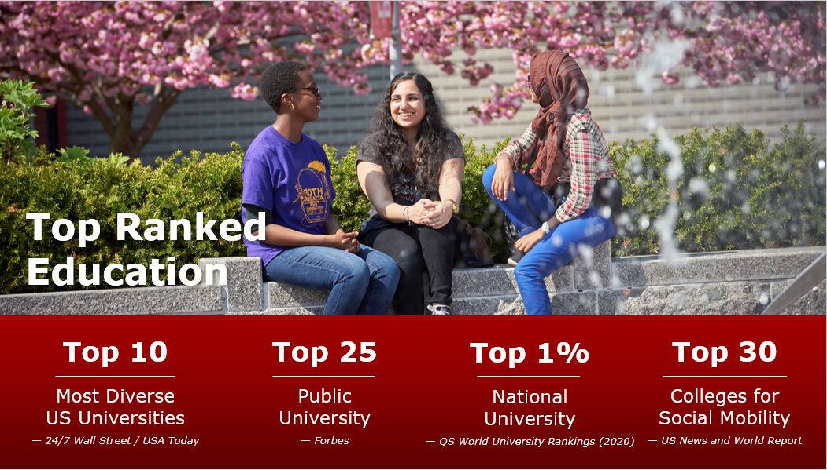

Slide 5

Notes:
200+ academic programs
About 100 are in the STEM fields but have SO much more
Major list in the tour bag or on our website
Only school of communication and journalism in SUNY
SoMAS – Southampton, RV Seawolf
Restricted majors

Slide 6
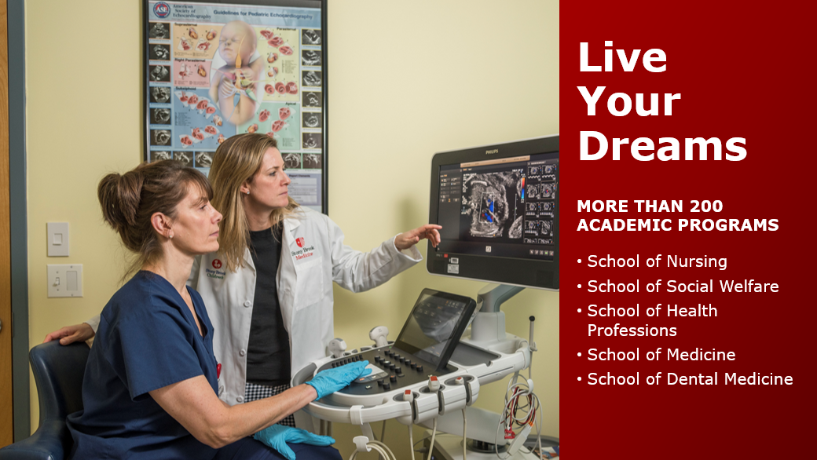

Slide 7


Slide 8
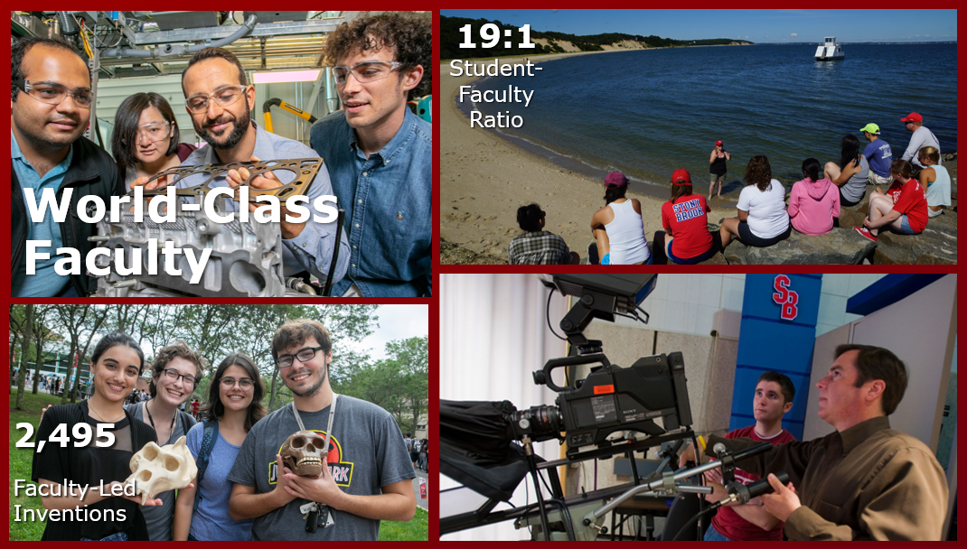

Slide 9


Slide 10

Notes:
HC – smallest and most competitive – traditional honors program with honors coursework, honors workshops, living with other honors students, etc.
WISE – Women in Science and Engineering – mentorship based honors with support and guidance throughout UG, GR, DR to increase the number of women in STEM
US – largest of all 3 programs – leadership based honors where they develop your skills, allow you to network with leaders in different careers and communities, and volunteer in our community and many others
In total, only about 400-500 of our 3500 new students will be invited into one of these programs, so it is not the traditional path of our students. However, it’s a wonderful opportunity for high achieving students (95+/1300+) to apply for a program with support and mentorship, special and unique research opportunities, and a community of like minded individuals.

Slide 11
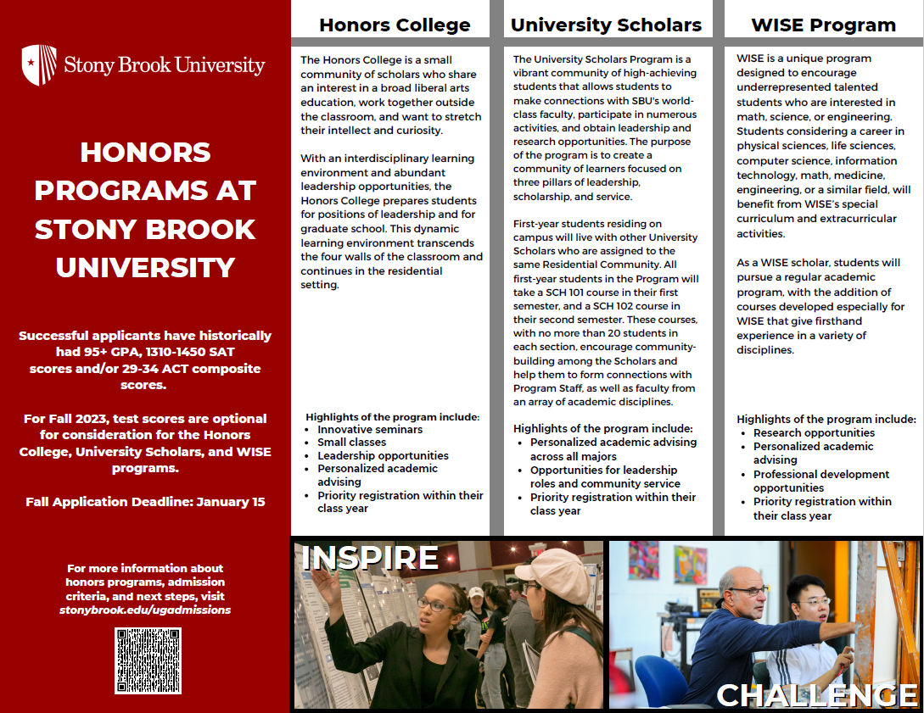

Slide 12


Slide 13
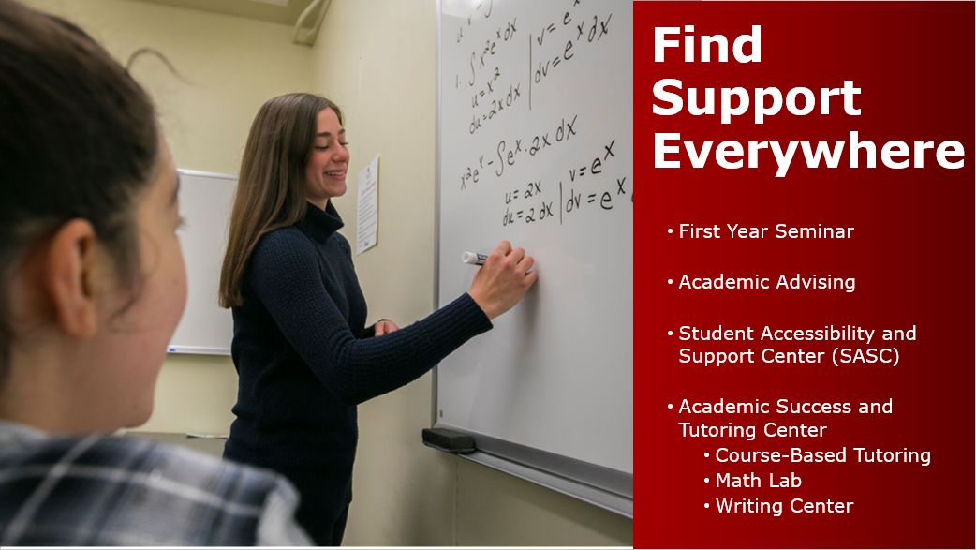

Slide 14
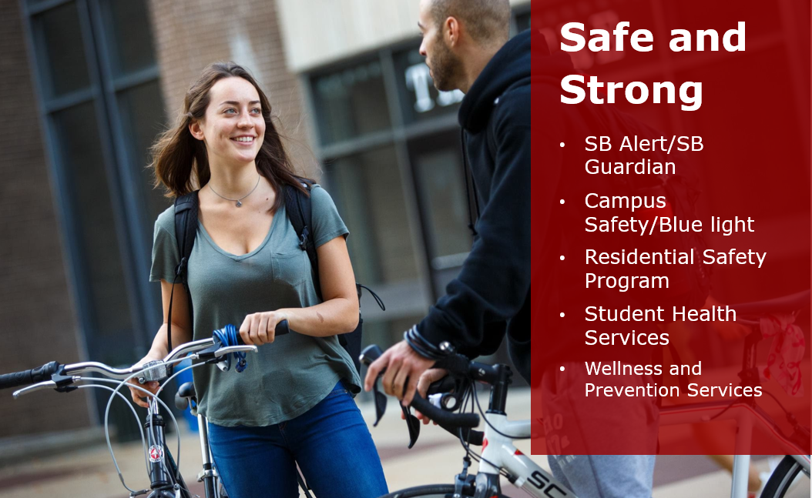

Slide 15


Slide 16
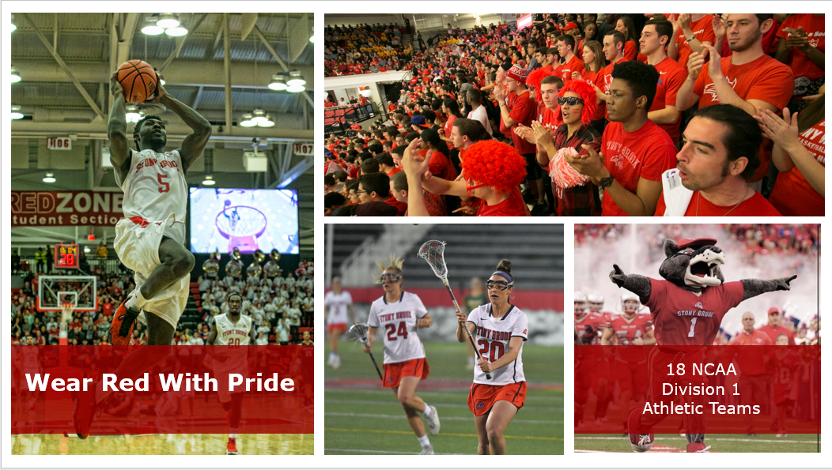

Slide 17
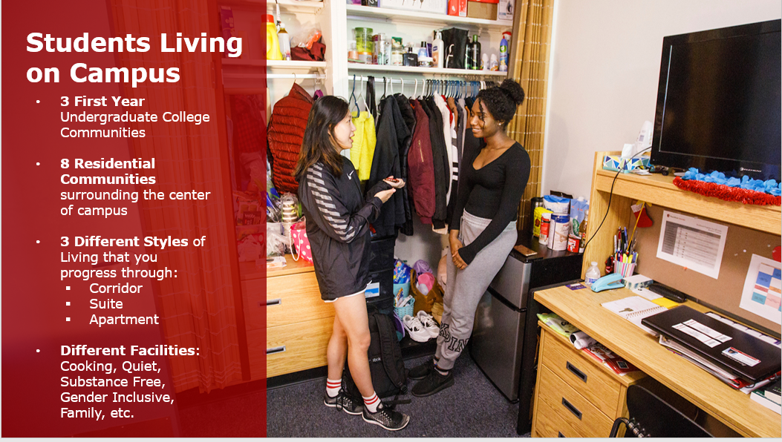
Notes:
Eleanor Roosevelt Community: Stimson will be for returner and new transfer students, Keller will be for first year students, Greeley will be for Scholars and first year students, and Wagner will be for WISE and first year students with the Undergraduate College of Creativity, Technology, & Innovation.
H Community: Benedict North (D/E Wings) will be for returner and new transfer students, Benedict South (A/B Wings) will be for Scholars and first year students, James will be for WISE and first year students, and Langmuir will be for first year students with the Undergraduate College of Global Health, Wellness, & Community.
Kelly Community: Hamilton, Schick, Eisenhower, Baruch and Dewey will be for returner and new transfer students.
Mendelsohn Community: Gray will be for returner and new transfer students, Ammann will be for Scholars and first year students, Irving will be for first year students, O’Neill will be for WISE and first year students with the Undergraduate College of Social Jusitice, Equity, & Ethics.
Roth Community: Gershwin, Cardozo, Mount, Hendrix, and Whitman will be returner and new transfer student buildings.
Tabler Community: Hand, Douglass, Dreiser, Sanger, and Toscanini will be returner and new transfer student buildings.
Chávez, Tubman, & Nobel Community: Lauterbur Hall will be reserved for Second Year Living Community (2YLC) , and Yang Hall is the home of the Honors College program and will have a limited number of spaces available for continuing students. Chávez and Tubman offer single rooms in suite style spaces for residents who have 57 or more credits (earned and currently enrolled credits) and are not on residential probation.
West Apartments offer apartment style spaces. Eligibility will continue to be available for residents who have 57 or more credits (earned cumulative credits and currently enrolled credits) and are not on residential probation.

Slide 18
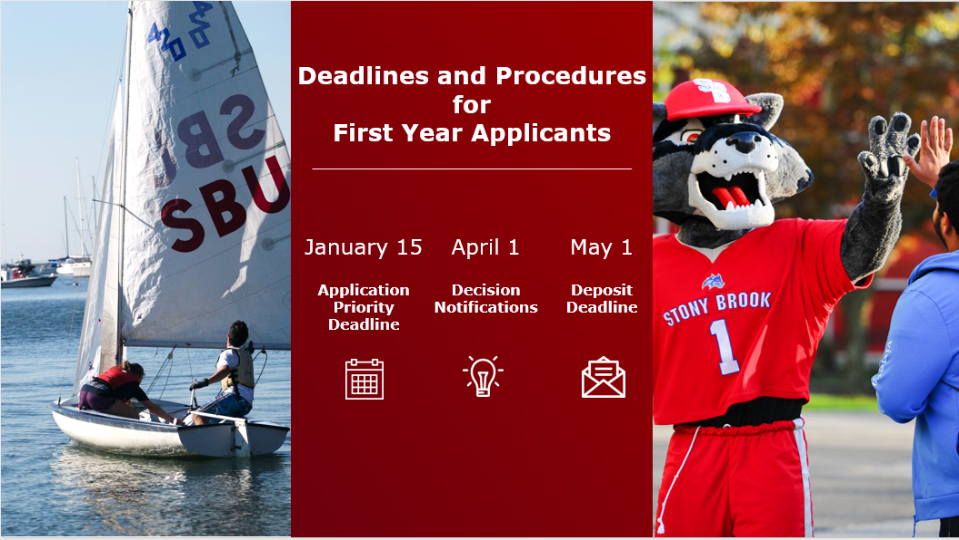

Slide 19
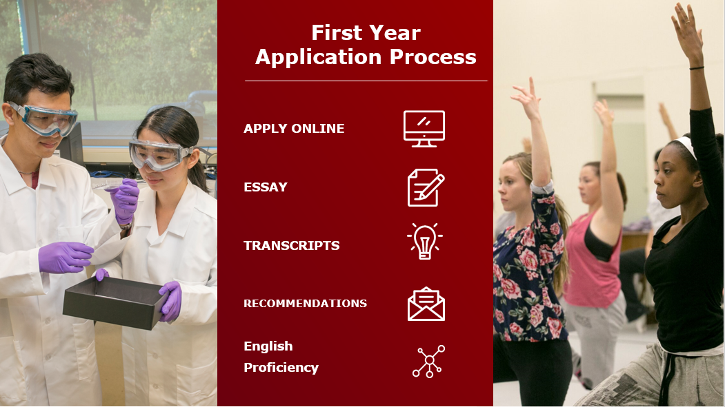
Notes:
Apply online – Common App, SUNY App or Coalition App – Use whatever app your school recommends as we do not have a preference
Essay is either included with your application or its supplement, or it can be uploaded into your Applicant Portal
Honors essays must be loaded through portal, and other items like resumes, portfolios or anything else not required can also be submitted through your portal
Transcripts can be sent via CA or SUNY app, emailed, or mailed to us by your counselors, in addition to your letters of recommendation (we only require 1 but typically see 2-3)
Test scores are optional for all programs for 2022 except Scholars for Medicine and Scholars for Dental Medicine
Check back with us next summer to see our updated testing policy

Slide 20
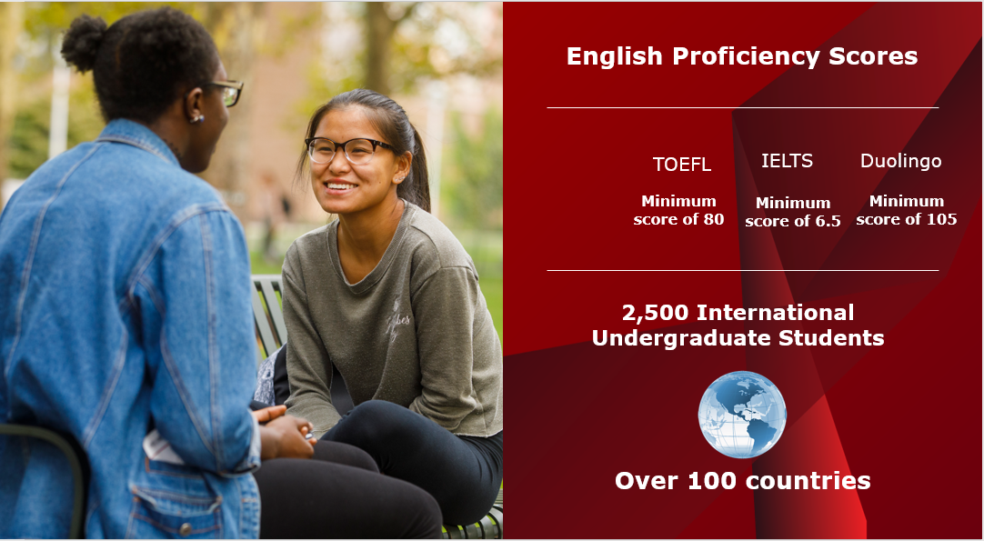
Notes:
Change photo
International admissions requirements
New Slide after this slide with average GPA 85 minimum English scores TOEFL 80, IELTS, 6.5, Duolingo 105
Over 2500 International undergrads from over 100 countries

Slide 21



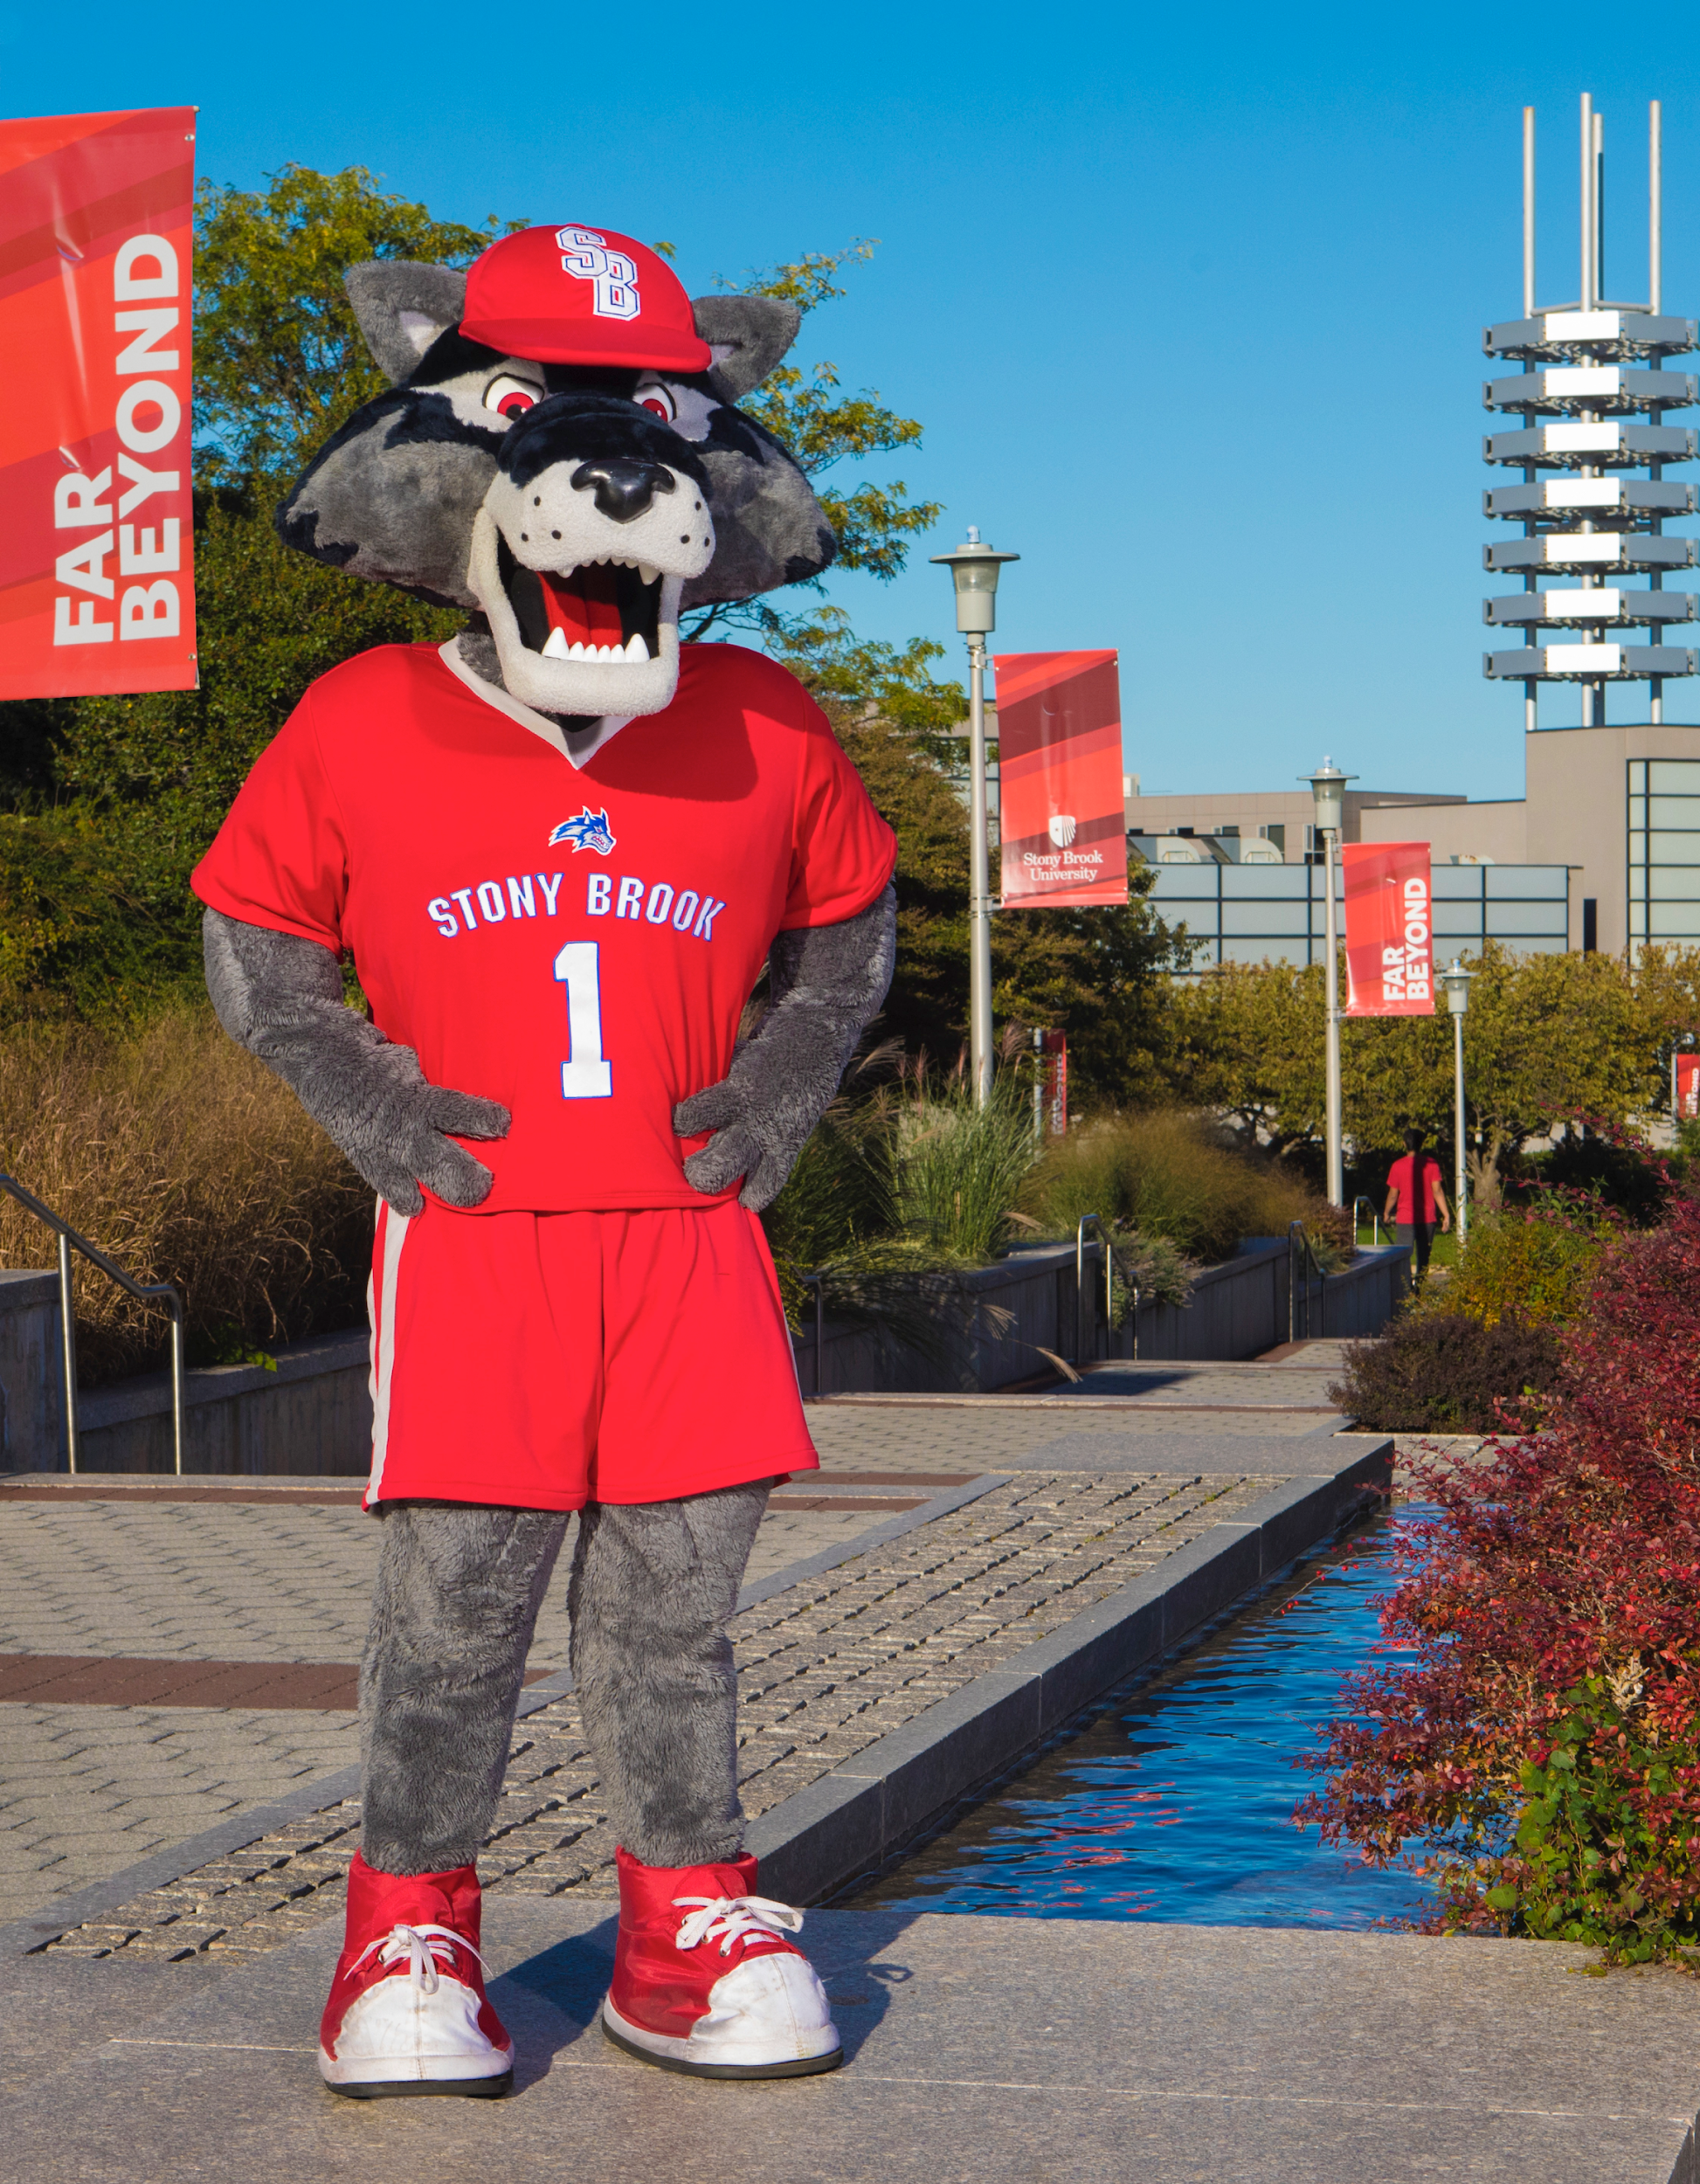
PROFILE OF FALL 2021 CLASS
FALL 2021 CLASS PROFILE
Values based on middle 50% of students who submitted test scores for evaluation
92-97
17%
38 states and 17 countries
1320-1460
High School GPA
(100-point scale)
SAT Scores
(Out of 1600)
RESIDENT
STATUS
83%
New York
State
3.7-4.0
29-33
High School GPA
(4-point scale)
ACT Scores
(Out of 36)
38,826
Applications
34 %
6 %
3,417
Enrolled
14 %
7 %
RACE/
ETHNICITY
9 %
48%
Admit Rate
27 % White
Notes:
We do not work with minimums and do not have admissions requirements so what you are looking at is the middle 50% of last years class. This gives you an idea of the average GPA and test scores of successful applicants last year
We typically look for around a 90 cumulative GPA
Higher for STEM (maybe 92+ with 4 years of science and math, Pre-Calc recommended
For Engineering, Comp Sci, Applied Math, its typically around a 94+ with Physics/Calc at minimum
For SAT’s we usually look for around a 1200 or higher (STEM/BUS: 1250, Engineering: 1300-1350, Comp Sci: 1450 with 700+ math) – So if you’ve taken the test and have achieved scores like this, we suggest to submit them! They will enhance your application. If you’re not meeting these general scores, I would say leave them out. There is no negative impact to not submitting scores, and no priority given to those that submit scores. We simply just don’t include scores in the review of students who choose not to submit them.

Slide 22

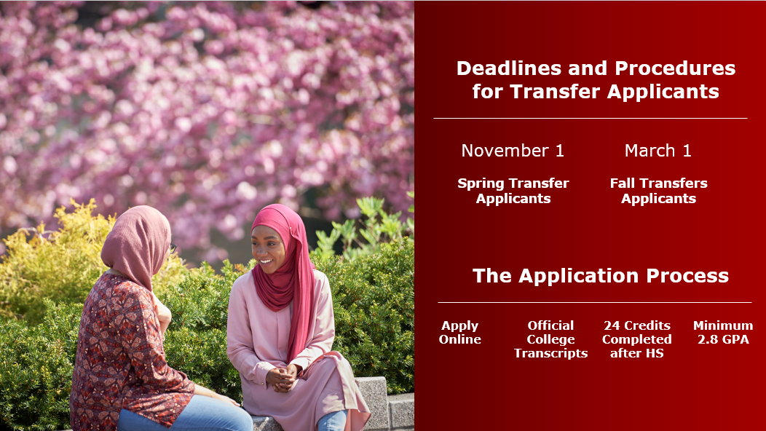
Deadlines and Procedures
for Transfer Applicants
November 1 | March 1
Spring Transfer Applicants | Fall Transfers Applicants
Apply Online | Official College Transcripts | 24 Credits Completed after HS | Minimum 2.8 GPA
The Application Process

Slide 23
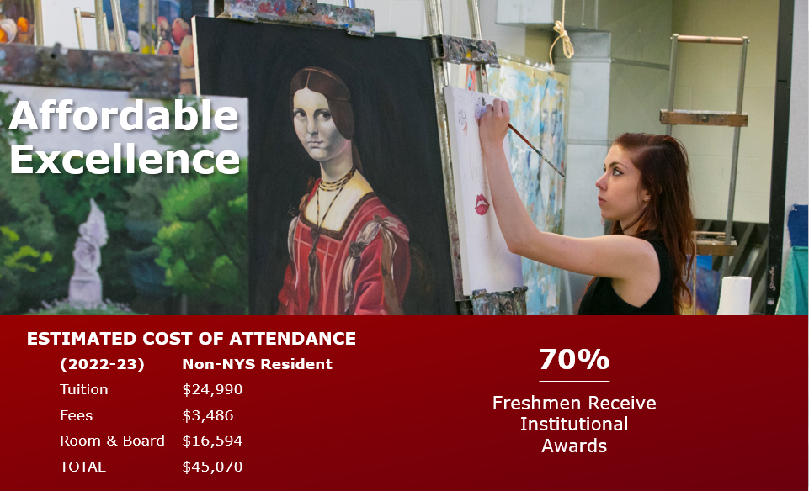

Slide 24
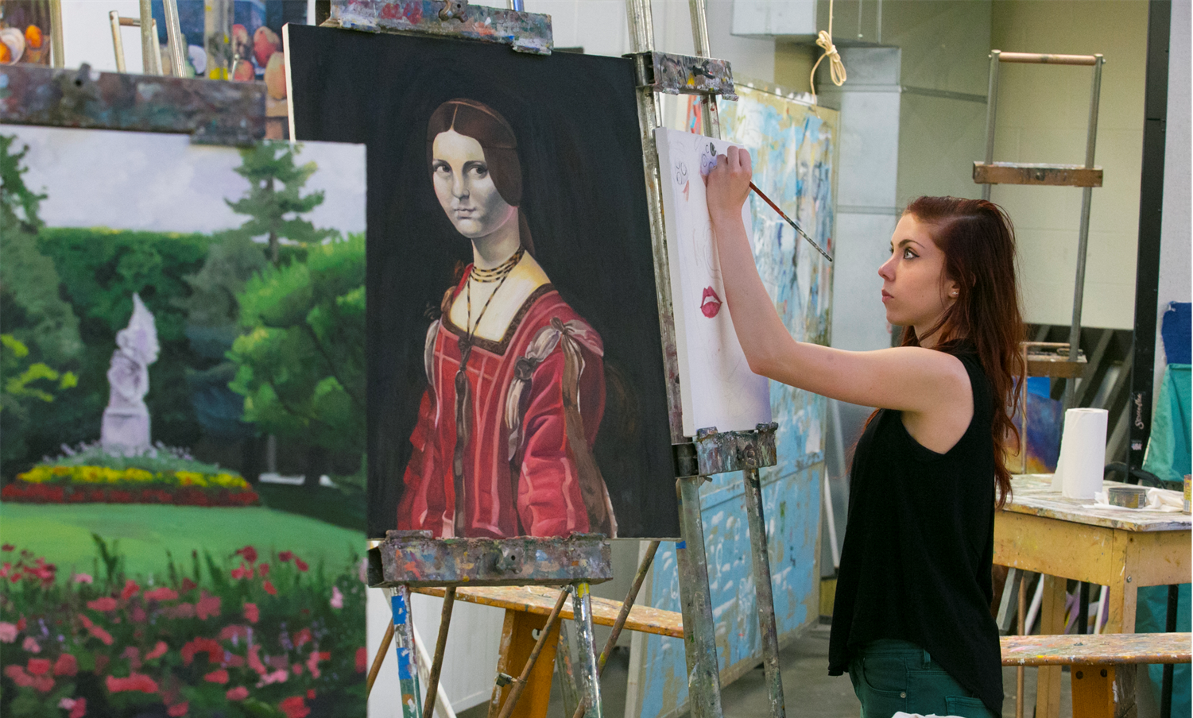
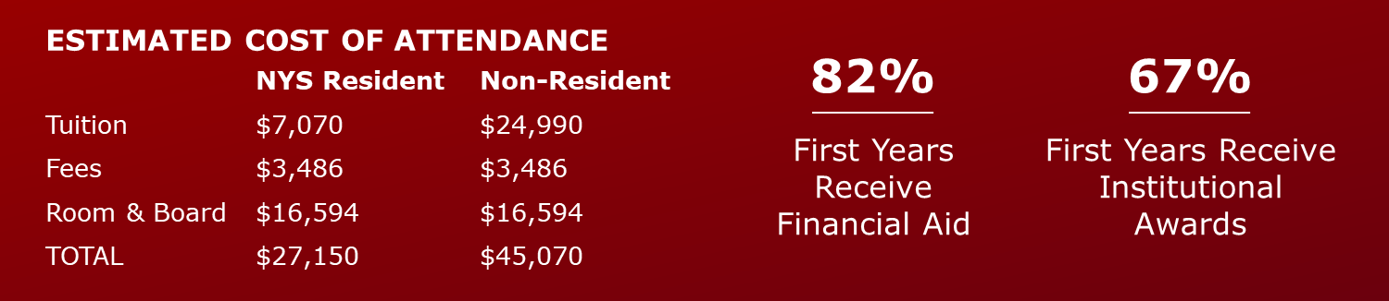

Slide 25
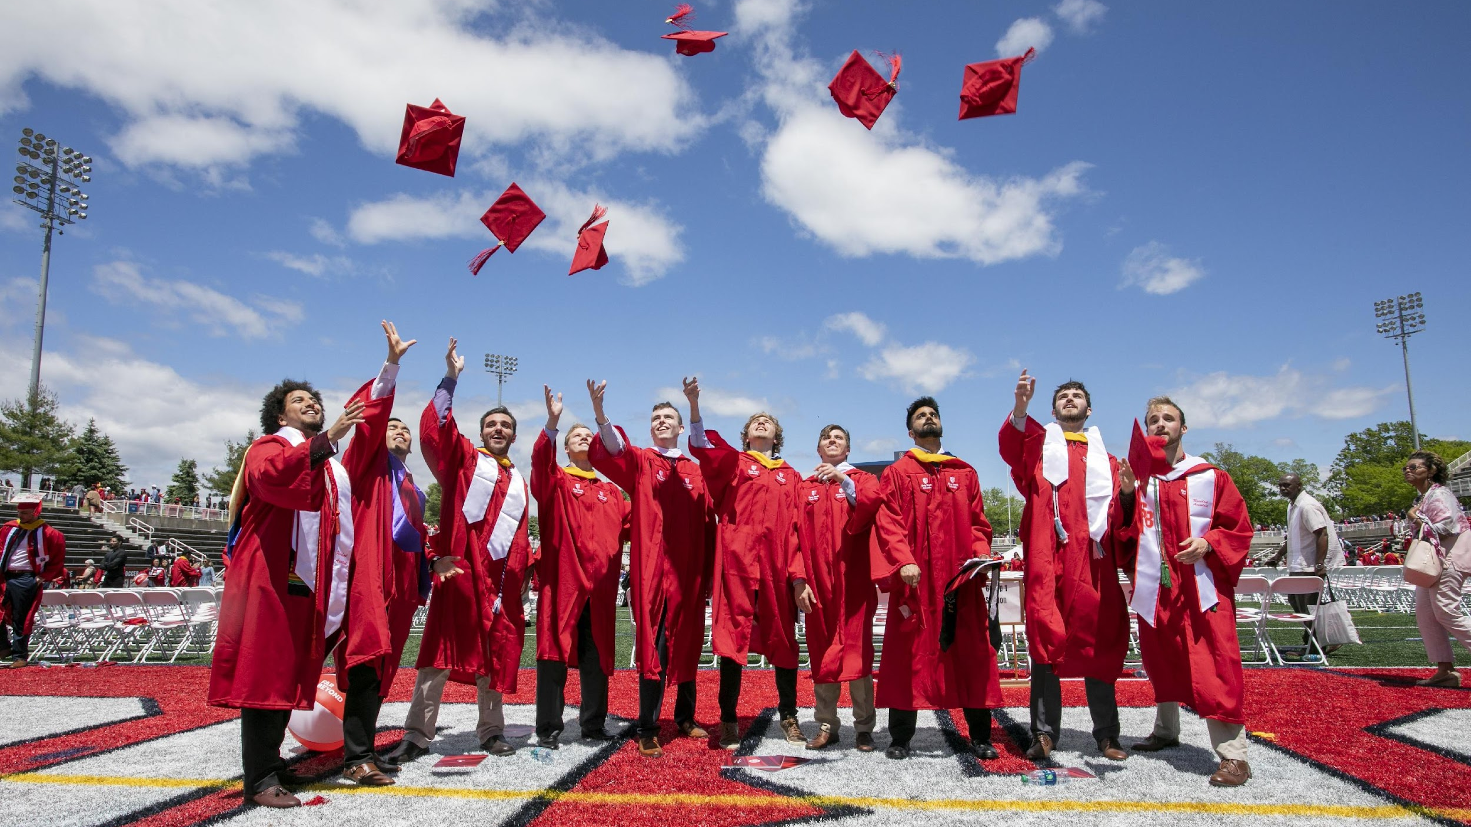
PREPPED
FOR
SUCCESS
95%
Graduates Employed
or Continuing Education
— 2020 Alumni Survey
Notes:
We care not just about your success when you’re with us, but even more so, once you leave us. We prepare you academically, financially, and in many other ways to achieve success as an SBU Alum, with about 95% of our students gainfully employed or furthering their education in a masters, doctorate, fellowship or other academic program.

Slide 26
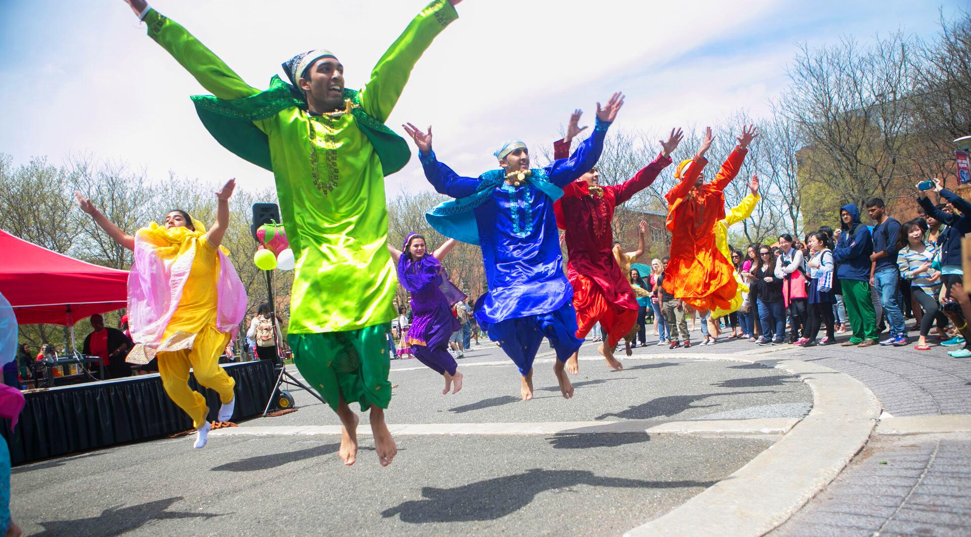
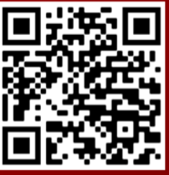




CONNECT WITH US
@stonybrooku
enrollintl@stonybrook.edu
Call: 631-632-6868
Notes:
Questions?

